Slide 1


DAYANANDA SAGAR UNIVERSITY
SCHOOL OF ENGINEERING
Computer Science and Engineering (AIML)
Minor Project
ECG PREDICTION AND ANALYSIS USING MACHINE LEARNING TECHNIQUES
Under the Supervision
Dr.Jayavrinda Vrindavanam and Prof.Pradeep Kumar k
Presented By:
Sana Banu (ENG22AM0053)
Sahana Priya G (ENG22AM0050)
Nagaboina Dharsini (ENG22AM0036)
Pooja N P (ENG23AM1002)
*
| CSE(AI&ML) DAYANANDA SAGAR UNIVERSITY
1
Notes:
Title of the project
CSE Dept., SET-Jain University
1

Slide 2
Content
Introduction
Literature Review
Problem Statement
Aim & Objectives
Detailed Architecture
Road map
References
*
| CSE(AI&ML) DAYANANDA SAGAR UNIVERSITY
2 of 12

Slide 3
INTRODUCTION
Cardiovascular diseases (CVDs) cause 17.9 million deaths annually, making early detection crucial for effective treatment.
ECG systems face issues with accuracy due to poor algorithms, integration, and artifact management, leading to unreliable analysis.
There is a need for better diagnostic accuracy, effective ECG data management, and seamless healthcare integration.
A mobile app using machine learning, artifact filtering, and secure data handling could address these issues and improve patient care.

Slide 4
Literature Review
Paper Title | Purpose | Efficiency | Methodology | Limitation
An ECG detection device based on Convolutional Neural Network | Integrates convolutional neural networks (CNN) for the real-time detection and diagnosis of premature atrial contractions. | The CNN model used in the device achieves an accuracy of 95.1%, with a precision of 95% and a recall rate of 97.9%. | The system combines hardware and software. It utilizes the MSP432P401R microcontroller and the ADS1292 bioelectric sensor for signal monitoring. | The current system is limited to detecting Premature Atrial Contractions (PAC) and requires improvements in terms of accuracy.
Medical Internet of Things for Classification of Pathological ECG Beats Based on Fractional Fourier Transform and Hyperparameter Tuning | The paper aims to use the Medical Internet of Things (MIoT) and advanced technologies like 6G.It integrates Fractional Fourier Transform (FrFT) and Deep Transfer Learning (DTL) for efficient ECG . | The proposed system achieved a classification accuracy of 99.68%. The DTL model with hyperparameter tuning proved to be more accurate and efficient . | Data Collection, Data Augmentation, Model Architecture. | The current model is limited to detecting five categories of heart conditions and requires further development to handle a wider variety of ECG abnormalities.
*
| CSE(AI&ML) DAYANANDA SAGAR UNIVERSITY
4 of 12

Slide 5
Paper Title | Purpose | Efficiency | Methodology | Limitation
ECG Diagnosis Device Based on Machine Learning | Develop a portable ECG diagnosis device using machine learning for real-time ECG signal processing and abnormality . | Achieved a diagnostic accuracy of 94.92% for detecting normal and abnormal ECG signals. | Data Preprocessing, Deep Learning Architecture, Fiducial Point Detection | The tool lacks integration with advanced signal processing techniques and is limited to fiducial point detection​
A Deep Learning-Based ECG Segmentation Tool for Detection of ECG Beat Parameters | Develop an automated ECG segmentation tool using deep learning to segment ECG beats and detect fiducial points (P, QRS, T waves) | Achieved 95% accuracy in ECG segmentation and 99.4% accuracy in fiducial point detection. | Preprocessing involved noise removal .The Conv-BiLSTM model was used to segment the ECG waves and detect fiducial points. | The tool lacks advanced signal processing integration and is limited to fiducial point detection​
Beat-wise Classification of Arrhythmia Using Novel Combination of ECG Signal with ML Algorithms | machine learning-based method for classifying arrhythmia at the beat level using a combination of ECG(derived from wavelet transformation). | The best performance was achieved of 94.7% using both signal specific and signal independent feature | The MIT-BIH Arrhythmia Database, which contains ECG recordings from various patients, was used for this study. | requires optimization in terms of resource usage and computational complexity for real-time applications​(Beat-wise Classificatio…).
*
| CSE(AI&ML) DAYANANDA SAGAR UNIVERSITY
5 of 12

Slide 6
Problem Statement​
Problem: Current ECG systems struggle with data management, algorithm inefficiencies, and integration challenges, leading to inaccurate diagnoses and inadequate monitoring; a mobile application is needed to address these critical issues.
​
Solution: Ultimately, our proposed mobile app harnesses advanced machine learning for accurate ECG analysis, features real-time artifact management, integrates seamlessly with healthcare platforms, and prioritizes user-friendly design and data security.
​

Slide 7
Aim & Objective​
Aim: This project we will create a mobile application that improves ECG data management and diagnostic accuracy using advanced algorithms. The app will handle real-time artifact removal, enable seamless integration with healthcare platforms, and ensure secure remote monitoring.​
Objective: This project is to develop a mobile app that enhances the accuracy of ECG data analysis through advanced algorithms, manages real-time artifacts, and integrates smoothly with healthcare systems. It will provide secure data handling, remote monitoring capabilities, and a user-friendly interface for efficient ECG management.​
Methodology: Implementing advanced machine learning algorithms for ECG analysis, integrating real-time artifact management, and developing a secure, user-friendly mobile app with seamless healthcare system integration for remote monitoring and data management.​
| CSE(AI&ML) DAYANANDA SAGAR UNIVERSITY

Slide 8





ARCHITECTURE
Presentation Layer (Flutter UI Components)
User Interface (UI) ,Splash Screen, Sign In, OTP, ECG Dashboard ,Historical Data, etc.
Business Logic Layer (BLoC, Provider, etc.) ,Use Authentication ECG Data Management State Management
Presentation Layer: Handles
user interface using Flutter.
Business Logic Layer: Manages app states and data flow.
Data Processing Layer: Analyzes ECG signals in real-time using machine learning.
Data Layer: Manages cloud integration and data storage, ensuring security and scalability.
Device Layer: Integrates with external wearable devices to collect and process real-time ECG data.
Notification and Alert System: Provides real-time alerts for abnormal heart activities.
Data Layer Firebase Authentication Cloud Storage (Firestore)API Integration Secure Data Handling
Data Processing Layer
Signal Processing Machine Learning Models Feature Extraction Artifact Management
Device Layer Bluetooth Device (ECG)Data Collection API
Notification & Alert System Real-Time Alerts Push Notifications

Slide 9
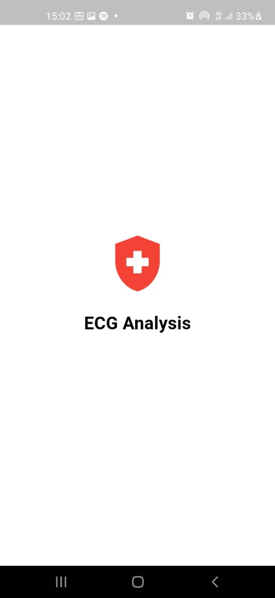
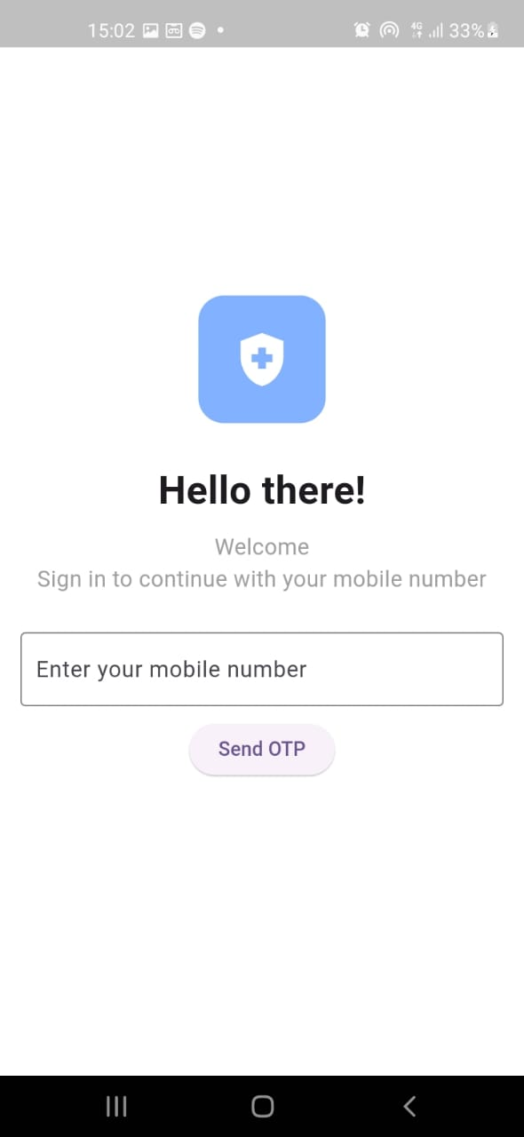
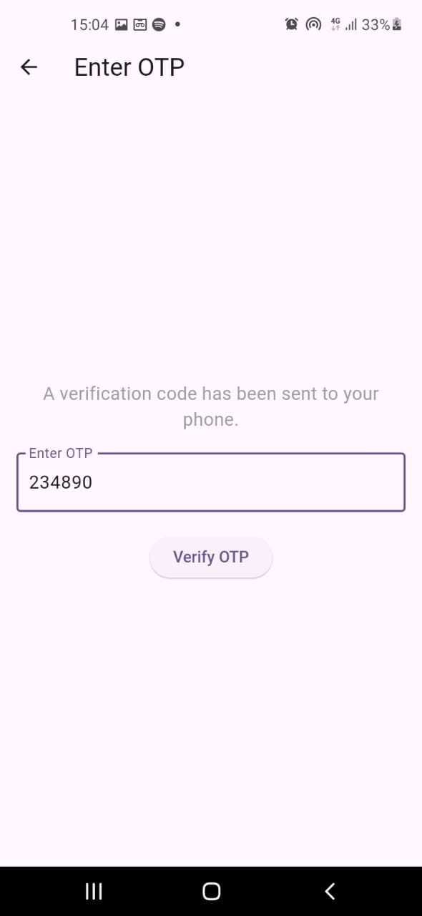
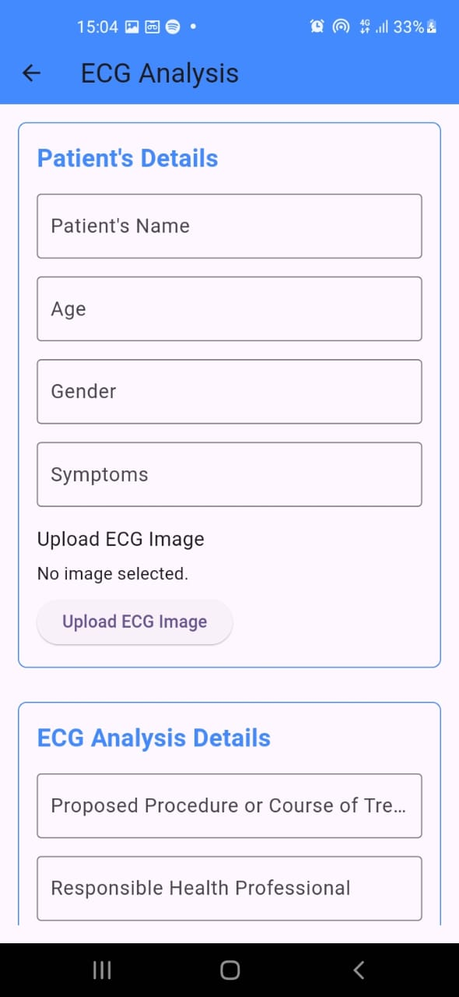
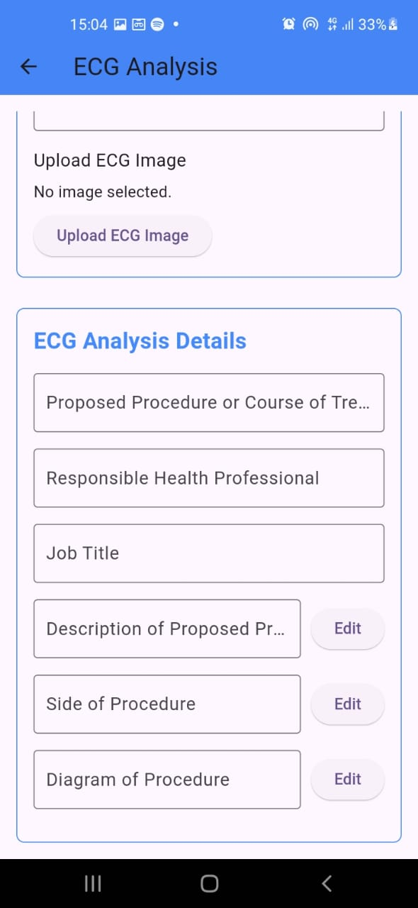

Slide 10
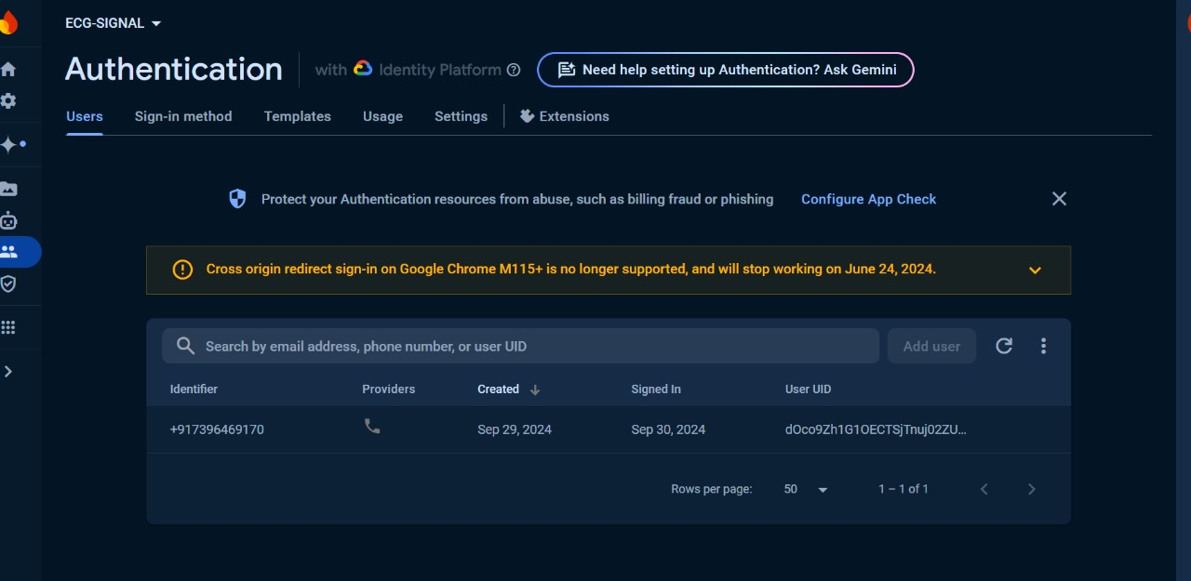
Backend Authentication using firebase

Slide 11
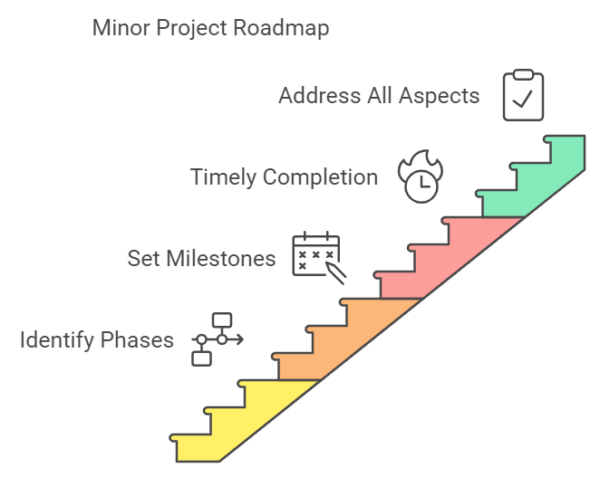
Road map of Backend Deployment using Django
1
2
3
4
5
6
7
Set Up Django Project
Configure database in settings.py
Add Your Model to the Django App
Create Views for Model Prediction
Define URLs for Your App
Run the Django Server
Test the API
*
CSE(AI&ML) DAYANANDA SAGAR UNIVERSITY
11

Slide 12
References
[1] Evaluation of ECG based Recognition of Cardiac Abnormalities using Machine Learning and Deep Learning
https://ieeexplore.ieee.org/document/9651457
[2 ] An ECG detection device based on Convolutional Neural Network
https://ieeexplore.ieee.org/document/10248472
[3] A Deep Learning Based ECG Segmentation Tool for Detection of ECG Beat Parameters
https://ieeexplore.ieee.org/document/9912906
[4 ]ECG diagnosis device based on machine learning
https://ieeexplore.ieee.org/document/9697057
[5] Beat-wise Classification of Arrhythmia Using Novel Combination of ECG Signal-Specific and Signal-Independent Features with ML Algorithms
Beat-wise Classification of Arrhythmia Using Novel Combination of ECG Signal-Specific and Signal-Independent Features with ML Algorithms | IEEE Conference Publication | IEEE Xplore
[6] A review on feature extraction and denoising of ECG signal using wavelet transform.
A review on feature extraction and denoising of ECG signal using wavelet transform | IEEE Conference Publication | IEEE Xplore
CSE(AI&ML) DAYANANDA SAGAR UNIVERSITY

